Slide 1

GEORGIA STATE UNIVERSITY
DEPARTMENT OF GEOSCIENCES
GEOGRAPHIC INFORMATION SYSTEMS
GEOG-6532/Fall 2019
GIS PROJECT
SPATIO-TEMPORAL ANALYSIS OF THE URBAN HEAT ISLAND (UHI)
IN ATLANTA
AHMADOU DEME

Slide 2
ABSTRACT
Over the last few decades, the urban area in Atlanta has increased significantly due to its rapid economic development. Thus, a large number of forest and cropland (natural landscapes) have been replaced by built-up areas (impervious surfaces). This has led to the formation and intensification of Urban Heat Island (UHI) in Atlanta. In the present study, to analyze the spatio-temporal variation of UHI in Atlanta using ArcGIS, time sequential Landsat 8 (May 15, 2000) and Landsat TM (May 1st, 2018) were used to retrieve LST and map land use/cover of the Atlanta metropolitan area for the past 18 years (from 2000 to 2018). Thus, this paper has modelled Atlanta Land Surface Temperature and classified its land use types in 2000 and 2018, and then analyzed the role of land use/covers and human activities (Urbanization) in urban heat island (UHI) evolution in Atlanta. The change detection map resulted from the land use types classification showed an exponential increase of urbans (suburbanization) at the expense of forest and cropland. Thus, Urban, Forest, Grassland, Water, and Soil are the five land use types defined in the area of study. Furthermore, the results of land surface temperature (LST) retrieval indicated that most of the heat islands of Atlanta remained over the central area from 2000 to 2018, and the intensity of the heat islands have considerably increased over the past 18 years. Finally, the effectiveness of the retrieval results was validated by combining the LST with the mean values of Atlanta air temperature acquired from NOAA, which shows a good relationship.
INDEX WORDS: UHI, Spatio-Temporal Variation, GIS

Slide 3
CONTENT
INTRODUCTION
MATERIALS AND METHODS
RESULTS AND INTERPRETATIONS
DISCUSSION AND FUTURE WORKS

Slide 4
INTRODUCTION
UHI: Temperature at the heart or the center of the city higher than its surroundings or the suburban area
SOURCE: NASA WEBSITE

Slide 5
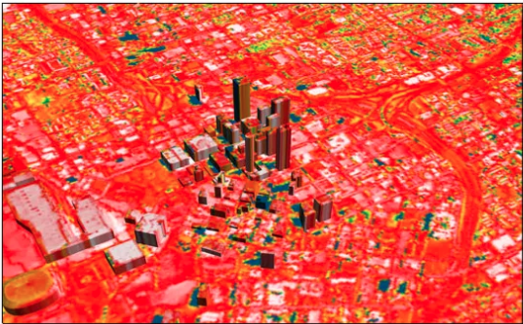
INTRODUCTION
Last few decades Atlanta affected by extreme heat, and it net increase in urban land has been dramatic
The urban heat island (UHI) effect changes heat and water cycles in Atlanta, and has been accused of elevating energy consumption and deteriorating living environment
Atlanta’s net increase in urban land from 1999 to 2050 is projected to be 928,379 ha at a rate of about 50 ha per day, representing an increase of 254% for the entire period; Yang and Lo (2003 )
SOURCE: NASA WEBSITE

Slide 6
INTRODUCTION
OBJECTIFS
1. Study the role of land use/covers and human activities (Urbanization) in urban heat island (UHI) evolution in Atlanta by analyzing its spatial and temporal variability from 2000 to 2018;
2. Modelling Atlanta Land Surface Temperature in 2000 and 2018 using GIS Raster Calculator;
3. Demonstrate usefulness Of GIS Techniques To Study Urban Heat Island.

Slide 7
MATERIALS AND METHODS
1. STUDY AREA
Atlanta, Georgia
SOURCE: Mapsofworld.com

Slide 8
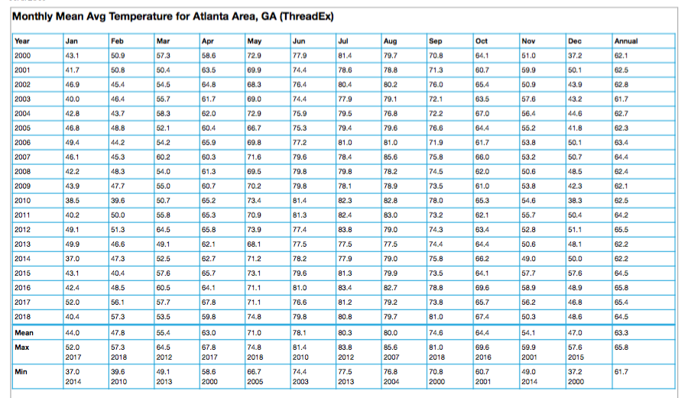
MATERIALS AND METHODS
2. Data
RASTER DATA: Landsat program, NASA, USGS
Landsat TM (Thematic Mapper) image from May 15, 2000;
Landsat 8 OLI/ TIRS image from May 1, 2018
METEOROLOGICAL DATA: NOAA, National Oceanic and Atmospheric Administration
Average Air Temperature
from 2000 to 2018, Atlanta

Slide 9
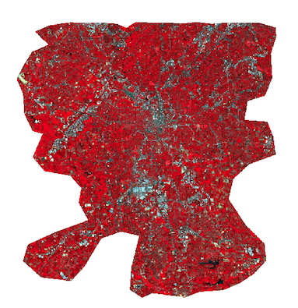
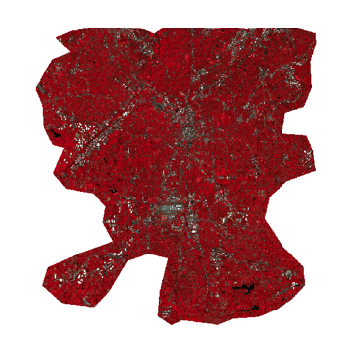
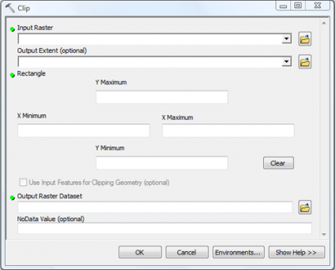
MATERIALS AND METHODS
3. IMAGE CLIPPING
2000
2018
SHAPEFILE

Slide 10
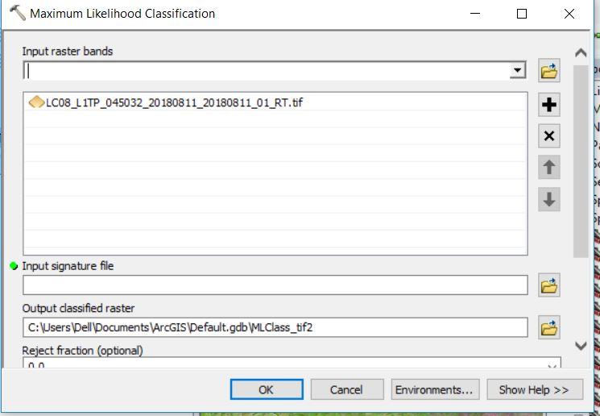
MATERIALS AND METHODS
4.METHODS
CLASSIFICATION OF LAND USE TYPES
Unsupervised Classification :
Change Detection MAP : From 2000 to 2018

Slide 11
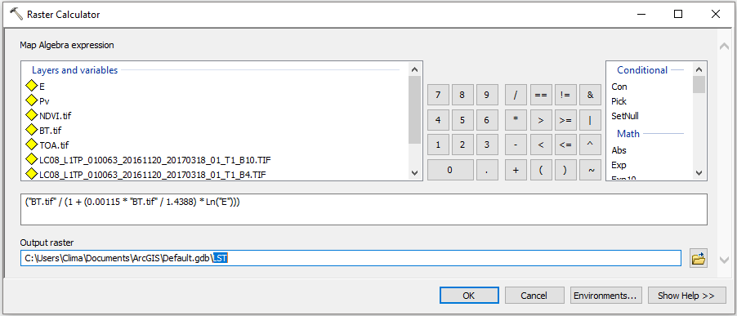
MATERIALS AND METHODS
LAND SURFACE TEMPERATURE RETRIEVAL; LST
2000 Image Thermal Band
2018 Image thermal bands
The methodology consists of using a set of equations through a raster image calculator in ArcGIS in order to estimate the LST
The process can be synthesized as following (USGS):

Slide 12
MATERIALS AND METHODS
LAND SURFACE TEMPERATURE RETRIEVAL; LST
STEP 1: Calculation of TOA (Top of Atmospheric) spectral radiance
TOA (L) = M_{L} * Q_{cal} + A_{L}
Where:
M_{L} = Band-specific multiplicative rescaling factor
Q_{cal} = corresponds to band 10/11 (for Landsat 8).
A_{L} = Band-specific additive rescaling factor
STEP 2: Brightness Temperature conversion
BT = (K₂ / (ln (K₁ / L) + 1)) − 273.15
K₁ = Band-specific thermal conversion constant from the metadata
K₂ = Band-specific thermal conversion constant from the metadata
L = TOA
STEP3: Calculate the NDVI
NDVI = (NIR – RED) / (NIR + RED)

Slide 13
MATERIALS AND METHODS
STEP 4: Calculate the proportion of vegetation P_{v}
P_{v} = Square ((NDVI – NDVI_{min}) / (NDVI_{max} – NDVI_{min}))
STEP 5: Calculate Land Surface Emissivity ε
ε = 0.004 * P_{v} + 0.986
STEP 6: Calculate the Land Surface Temperature
𝑇𝑠 = (BT / (1 + (λ* BT / 1.4388) * Ln(ε)))
Where,
𝑇𝑠 is the LST in Celsius (∘ C );
BT is at-sensor BT ( ∘ C);
𝜆 is the wavelength of emitted radiance;
𝜀 is the emissivity.

Slide 14
RESULTS AND INTERPRETATIONS
1.TEMPORAL AND SPATIAL VARIATION OF LST
AVERAGE
LST
27.8 °C
AVERAGE
LST
28.6 °C

Slide 15
RESULTS AND INTERPRETATIONS
3.LAND USE TYPES

Slide 16
RESULTS AND INTERPRETATIONS
4.CHANGE DETECTION MAP
YEARS |  | CHANGES
Class-2000 | Class-2018 | Count | Hectares | Percentages
Urban | Urban | 421131 | 37901.79 | 11.65
Urban | Forest | 357231 | 32150.79 | 9.89
Urban | Grassland | 174719 | 15724.71 | 4.84
Urban | Water | 2007 | 180.63 | 0.06
Urban | Soil | 8756 | 788.04 | 0.24
Forest | Urban | 167489 | 15074.01 | 4.64
Forest | Forest | 1652040 | 148683.6 | 45.72
Forest | Grassland | 230698 | 20762.82 | 6.38
Forest | Water | 2162 | 194.58 | 0.06
Forest | Soil | 10345 | 931.05 | 0.29
Grassland | Urban | 39035 | 3513.15 | 1.08
Grassland | Forest | 247546 | 22279.14 | 6.85
Grassland | Grassland | 134728 | 12125.52 | 3.73
Grassland | Water | 159 | 14.31 | 0.00
Grassland | Soil | 2838 | 255.42 | 0.08
Water | Urban | 3531 | 317.79 | 0.10
Water | Forest | 1642 | 147.78 | 0.05
Water | Grassland | 219 | 19.71 | 0.01
Water | Water | 26874 | 2418.66 | 0.74
Water | Soil | 65 | 5.85 | 0.00
Soil | Urban | 9443 | 849.87 | 0.26
Soil | Forest | 35764 | 3218.76 | 0.99
Soil | Grassland | 84495 | 7604.55 | 2.34
Soil | Water | 84 | 7.56 | 0.00
Soil | Soil | 357 | 32.13 | 0.01
TOTAL |  | 3613358 | 325202.22 | 100

Slide 17
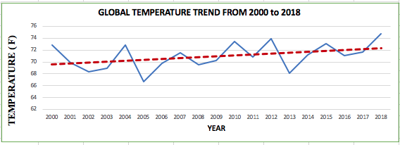
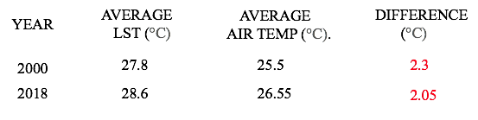
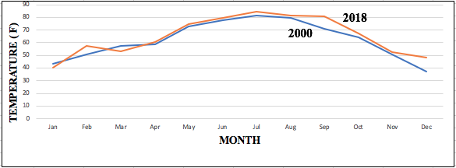
RESULTS AND INTERPRETATIONS
5.PRECISION VERIFICATION
GOOD LINEAR RELATIONSHIP BEETWEN
LST AND MEASURED AIR TEMPERATURE
THE EFFECTIVENESS
OF THE LST RESULT

Slide 18
DISCUSSION AND FUTURE WORKS
Atlanta land use has a significant driving effect on land surface temperature. In fact, the expansion of the city from 2000 to 2018 has led to surface changes, which has greatly intensified UHI effects.
A large number of natural landscapes have been replaced by impervious surfaces from 2000 to 2018. This caused the new urban area to rapidly become a new high LST area in Atlanta.
The decrease in vegetation coverage and increase in grasslands from 2000 to 2018, have caused rapid evaporation of the surface moisture of the soil, and then decrease in soil water content due to solar radiation.
Socio-Economic Factors have also a strong driving effect on land surface temperature. In fact, the expansion of the city in size along with the growth of urban from 2000 to 2018, lead to the increase in amount of anthropogenic heat release du to human population grown in urban environment.
The comparison between the mean values of Atlanta air temperature acquired and the LST values on May 2000 and May 2018 shows the effectiveness of the results: Good linear relationship.
FUTURE WORK: Include interpolation methods (inverse distance weighting, kriging, multiple linear regression, etc.) in land surface temperature retrieval, and land cover classification

Slide 19
REFERENCES / BIBLIOGRAPHY
1. Akbari, H., Pomerantz, M., & Taha, H. (2001). Cool surfaces and shade trees to reduce energy use and improve air quality in urban areas. Solar energy, 70(3), 295-310.
2. Akbari, H., Berdahl, P.,& Rose, L. S. (2002). Aging of reflective roofs: soot deposition. Applied optics, 41(12), 2355- 2360.
3. Atkinson B W (2003). Numerical modelling of urban heat-island intensity. Boundary Layer Meteorology 109(3):285-310
4. Bouyer, J., Musy, M., Huang, Y., & Athamena, K. (2009). Mitigating urban heat island effect by urban design: forms and materials. Paper presented at the Proceedings of the 5th urban research symposium, cities and climate change: responding to an urgent agenda, Marseille.
5. Bousse, Y. S. (2009). Mitigating the urban heat island effect with an intensive green roof during summer in Reading, UK. Dissertação de Mestrado, University of Reading.
6. Masson, V. (2006). Urban surface modeling and the meso- scale impact of cities. Theoretical and Applied Climatology, 84(1-3), 35-45.
7. Mobaraki, A. (2012). Strategies for Mitigating Urban Heat Island Effects in Cities: Case of Shiraz City Center. Eastern Mediterranean University (EMU).
8. Oke, T.R. (1997). Urban Climates and Global Environmental Change. In: Thompson, R.D. and A. Perry (eds.) Applied Climatology: Principles & Practices. New York, NY: Routledge. pp. 273-287.
9. Oke, T.R.(1982).The energetic basis of the urban heat island. Quarterly Journal of the Royal Meteorological Society, 108(455), 1-24.
10. Okwen, R., Pu, R.,& Cunningham, J.(2011). Remote sensing of temperature variations around major power plants as point sources of heat. International journal of remote sensing, 32(13), 3791-3805.

Slide 20
11. Priyadarsini, R., Hien, W. N., & David, C. K. W. (2008). Microclimatic modeling of the urban thermal environment of Singapore to mitigate urban heat island. Solar energy, 82(8), 727-745.
12. Quattrochi, D. A., J. C. Luvall, and M. G. Estes Jr, (1999). Project ATLANTA (Atlanta Land use Analysis: Temperature and Air Quality): Use of Remote Sensing and Modeling to Analyze How Urban Land Use Change Affects Meteorology and Air Quality Through Time. NASA technical report, 2147483647.
13. Santamouris, M., Paraponiaris, K., & Mihalakakou, G. (2007). Estimating the ecological footprint of the heat island effect over Athens, Greece. Climatic Change, 80(3-4), 265-276.
14. Synnefa, A., Dandou, A., Santamouris, M., Tombrou, M., & Soulakellis, N. (2008). On the use of cool materials as a heat island mitigation strategy. Journal of Applied Meteorology and Climatology, 47(11), 2846-2856.
15. Shahmohamadi, P., Che-Ani, A., Ramly, A., Maulud, K., & Mohd-Nor, M. (2010). Reducing urban heat island effects: A systematic review to achieve energy consumption balance. Paper presented at the Phys. Sci.
16.Taha, H. (1997). Urban climates and heat islands: albedo, evapotranspiration, and anthropogenic heat. Energy and buildings, 25(2), 99-103.
17.United States Environmental Protection Agency. (August, 2013). Heat Island Impacts. Retrieved From http://www.epa.gov/hiri/impacts/index.htm
18.UCAR, Center for Science Education. (2011). Urban Heat Islands. Retrieved From http://scied.ucar.edu/longcontent/urban-heat-islands
19. Voogt, J. A. (2004). Urban heat islands: hotter cities. America Institute of Biological Sciences.
20.Weng, Q.H.; Yang, S.H. Managing the adverse thermal effects of urban development in a densely populated Chinese city. J. Environ. Manag. 2004, 70, 145–156
21. Yamamoto, Y. (2006). Measures to mitigate urban heat islands. Science and Technology Trends Quarterly Review, 18(1), 65- 83.
22. Yang, X., and C. P. Lo, (2003). Modeling Urban Growth and Landscape Change for Atlanta Metropolitan Region. International Journal of Geographical Information Science, 17, 463-488

